Slide 1


Predicting House Prices Using Machine Learning
Gradient Boosting Regressor with Hyperparameter Tuning

Slide 2

Project Overview
Goal: Build a machine learning model to estimate the price of residential houses based on the structured information.
Dataset: 10,000 artificialsafe UK property listings created with NumPy and pandas.
Tools and Libraries Python, scikit-learn, Gradio, pandas, seaborn

Slide 3
Research Workflow
Define the Research Problem
Clearly state the research question or problem to be addressed. This sets the foundation for your entire study.
Review Literature
Conduct a thorough literature review to understand the existing research and identify gaps or areas where your study can contribute.
Data Collection
Gather the data necessary to address your research question. This could involve surveys, experiments, observations, or secondary data from existing sources.
Data Analysis
Analyze the collected data using appropriate statistical, qualitative, or computational methods to derive meaningful insights.
Interpret Results
Interpret the analysis in the context of your research question, drawing conclusions and identifying the implications of your findings.
Present Findings
Summarize your results in a clear and concise format, typically in a report, paper, or presentation, and share your findings with the relevant audience.

Slide 4

K-means vs KNN
K-means (Unsupervised): Discovers latent clusters.
KNN (Supervised): Nearest neighbor prediction.
Differences:
Pattern discovery vs prediction: This is the goal of prediction.<|human|>Pattern discovery vs prediction: This is what prediction is all about.
• training: Centroids vs. stores learns all.
• Output: Cluster vs class prediction.

Slide 5
Overfitting & Loss Functions
Overfitting:
Definition: Occurs when a model learns the training data too well, including noise and outliers, leading to poor performance on new, unseen data.
Symptoms: High accuracy on training data, but low accuracy on test/validation data.
Causes:
Too complex models (many parameters).
Insufficient training data.
Long training periods without early stopping.
Prevention:
Use cross-validation.
Apply regularization (L1/L2).
Use early stopping during training.
Increase training data or use data augmentation.
Loss Functions:
Definition: A mathematical function that measures the error between predicted and actual values, guiding model optimization.
Common Loss Functions:
Mean Squared Error (MSE): Measures average squared differences between predicted and actual values (more sensitive to outliers).
Mean Absolute Error (MAE): Measures average absolute differences (robust to outliers).
Huber Loss: Combines MSE and MAE, less sensitive to outliers than MSE but more stable than MAE.
Purpose: Minimize the loss function during training to improve model accuracy.

Slide 6
Key Results
Gradient Boosting: RMSE = 20,378, R² = 0.92 (Best)
Random Forest: RMSE = 21,432, R² = 0.90
Linear Regression: RMSE = 20,455, R² = 0.91
Others (KNN, SVR): RMSE > 50,000, R² < 0.3
Best Model: Gradient Boosting Regressor
Deployed via Gradio with input validation

Slide 7
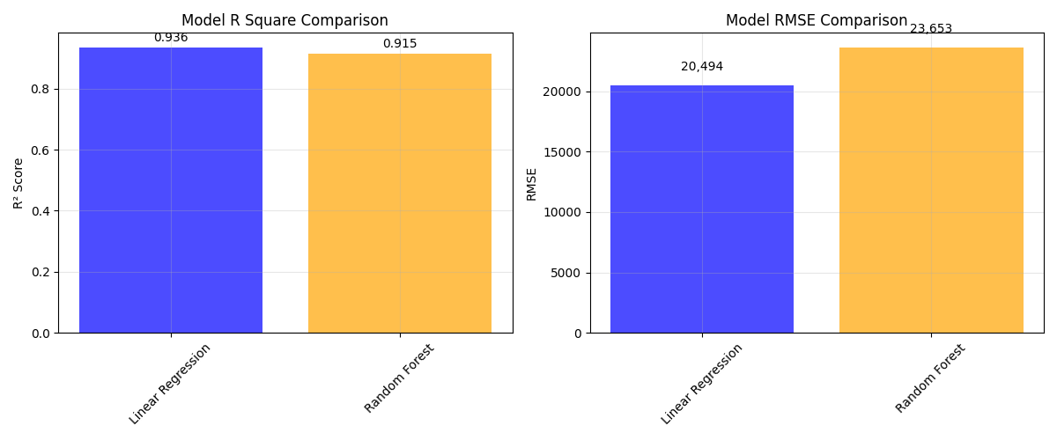
RMSE Comparison R² Comparison

Slide 8
Ridge Regression & XGBoost
Ridge Regression:
• Adds L2 penalty to reduce overfitting.
• Tuned with alpha parameter to control regularization.
• Performs better when multicollinearity exists.
XGBoost:
• Gradient boosting algorithm optimized for speed & accuracy.
• Handles missing data well, prevents overfitting via regularization.
• Strong for structured/tabular datasets like housing prices.

Slide 9
Challenges Faced
Synthetic Dataset: Limited real-world applicability and potential data discrepancies.
Overfitting: Random Forest overfitted to training data, affecting generalization.
Model Selection: Choosing between simpler models (Linear Regression) and complex ones (Random Forest, XGBoost).
Hyperparameter Tuning: Time-consuming and required extensive optimization, with limited improvement.

Slide 10
Lessons Learned
Model Simplicity Linear Regression
Overfitting Prevention Ridge Regression
Evaluation metrics (RMSE, R²) offer complete performance insight
Validation improves reliability of user-facing apps
A clean pipeline ensures reproducible results

Slide 11
Conclusion
this project highlighted the importance of selecting appropriate machine learning models and techniques for predicting house prices based on structured data. The analysis demonstrated that Linear Regression, despite its simplicity, provided a stable and generalizable solution, outperforming more complex models like Random Forest and XGBoost in terms of overall reliability and ease of interpretation. The challenges faced, including issues with overfitting, data imbalance, and the time-consuming nature of hyperparameter tuning, emphasized the need for careful model selection, feature engineering, and regularization to ensure accurate and efficient predictions. Additionally, the project reinforced the significance of data preprocessing, including handling missing values and encoding categorical features, as well as the value of using multiple evaluation metrics to assess model performance comprehensively.

Slide 12
References
Adamson, A.S. and Smith, A., 2018. Machine learning and health care disparities in dermatology. JAMA dermatology, 154(11), pp.1247-1248.
Ahmed, N., Michelin, R.A., Xue, W., Ruj, S., Malaney, R., Kanhere, S.S., Seneviratne, A., Hu, W., Janicke, H. and Jha, S.K., 2020. A survey of COVID-19 contact tracing apps. IEEE access, 8, pp.134577-134601.
Arulkumaran, K., Deisenroth, M.P., Brundage, M. and Bharath, A.A., 2017. Deep reinforcement learning: A brief survey. IEEE signal processing magazine, 34(6), pp.26-38.
Chen, W., Yeo, C.K., Lau, C.T. and Lee, B.S., 2018. Leveraging social media news to predict stock index movement using RNN-boost. Data & Knowledge Engineering, 118, pp.14-24.
Dastin, J. (2018). Amazon scraps secret AI recruiting tool that showed bias against women. Reuters. Retrieved from https://www.reuters.com/article/us-amazon-com-jobs-automation-insight-idUSKCN1MK08G
Gorwa, R., Binns, R. and Katzenbach, C., 2020. Algorithmic content moderation: Technical and political challenges in the automation of platform governance. Big Data & Society, 7(1), p.2053951719897945.

Slide 13
Thank You
Any Questions?

